Slide 1


Drone Based Mapping and Ground Based Robotic Precision Spray System for Field Crops

Slide 2
The Team
Logan Sutton
  Computer Science and Applied Math Double Major
  Familiar with backend/api development
  Leading UI and API solutions
Gil Rezin
  Computer Science Major & Math Minor
  Familiar with machine learning and its applications
  Leading generation of pesticide prescription using ML

Slide 3
Sprint 1 Objectives/Goals
Collect Requirements from Andrew Nelson
  Get overview of overall project
  Visit farm
Create user stories and identify functional requirements
Learn full stack framework
  Python
    Backend use
    FastAPI
    DINOv2
    TensorFlow
  R
    FIELDimageR
  JavaScript/React
    Frontend use
  OpenDroneMap
    Used to process images
    NodeODM docker image
    PyODM library

Slide 4
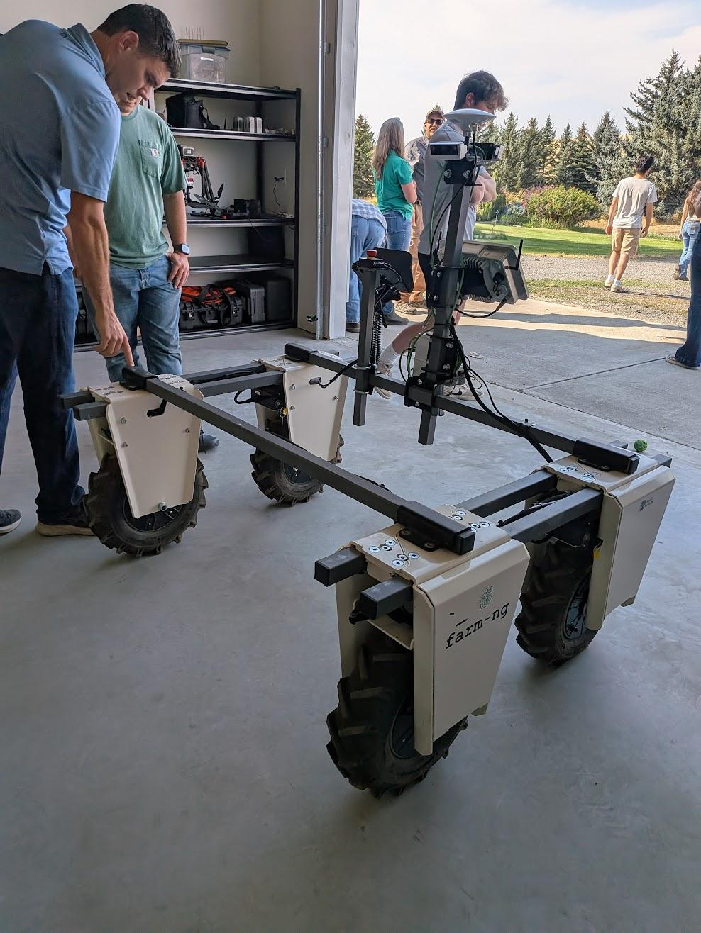
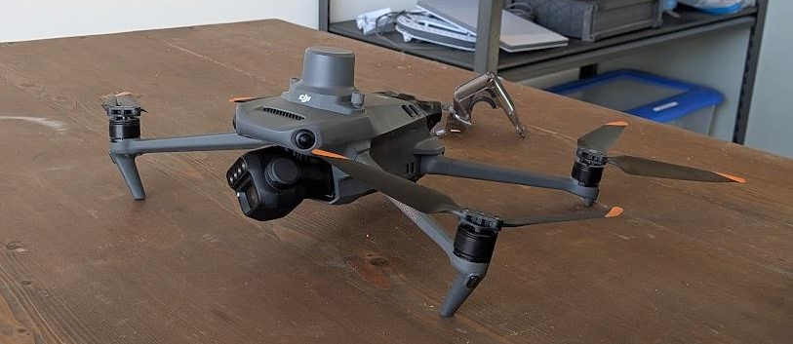
Requirement Gather Process
Visited Andrew’s Farm in person
  Intro to problem statement
    Farm-ng, Farm Robotics competition, automated robotic sprayer
    Resources: Farm-ng robot, drone hardware & imagery
Ag Team Meeting (9/12)
  Requirement pipeline
    Main goal: create something usable and affordable for farmers (off the shelf)
Stitch drone imagery
Generate prescription
Generate path
Send to robot

Slide 5
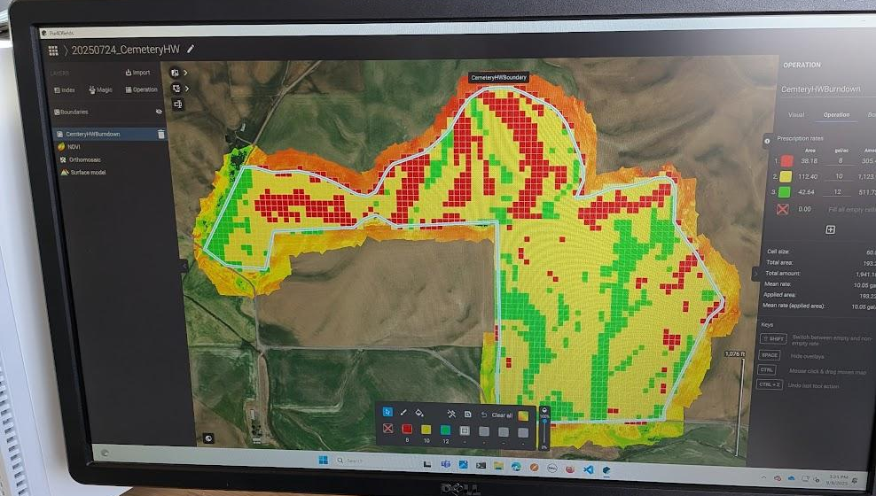
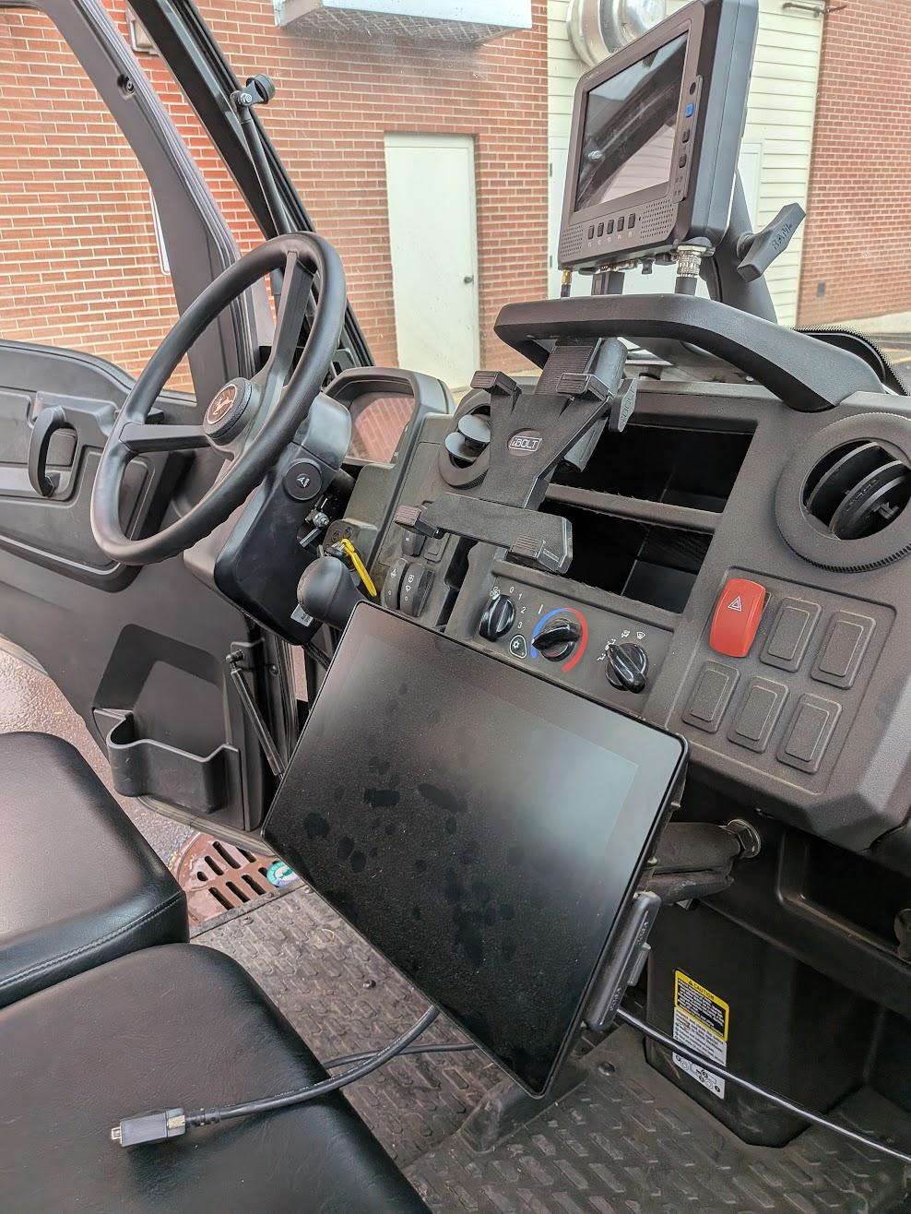
Requirement Gather Process
Technical Software Meeting (9/25)
  Suggested tools/requirements
    AI generated UI
    NodeODM for stitching
    ML model for generating prescription/field map
    Fully automated process after uploading drone imagery
    Must fully work offline for remote farmers
    Evaluate effectiveness & accuracy
Additional Overview Meeting (10/2) + shop visit
  Additional meeting for grad mentor
    Repeat of project overview
    Farm NG competition proposal due (11/14)
    Use off the shelf parts, want project to be actually implementable by farmer
  John Deere ATU possibility, needs exploring by engineering team
MoM Example

Slide 6
User Stories
US-01: Upload Drone Imagery
As an end-user farmer, I want an Upload Drone Imagery button so that I can easily upload my drone’s images to generate a field map.
US-02: Transfer Prescription to Robot
As an end-user farmer, I want to have the system upload the generated prescription to my spraying robot, so I do not have to manually upload the prescription for each spray.
US-03: Individual Nozzle Control
As a sprayer robot, I want to be able to control each sprayer nozzle individually so I can minimize pesticide resource expenditure.
US-04: Evaluate Spraying Effectiveness
As a team, we want to be able to measure the effectiveness of the robotic sprayer in order to continually improve our ML model.
Notes:
Focus on farmer’s wants and needs, practicallity

Slide 7
Use Cases
Use Case | Calculate and Execute Optimal Spraying Path
Actors | Farmer, Robot Sprayer
Pre-condition | Field map and pesticide prescription are available. System is connected to the robot sprayer.
Post-condition | Robot sprayer completes the spraying operation following the optimized path based on the prescription.
Main Flow | - System calculates the most efficient and safe spraying path, considering obstacles (e.g., telephone poles, steep hills). - Farmer previews the generated path overlaid on the field map. - Approved prescription and path are uploaded to the robot sprayer. - Robot sprayer executes the operation, controlling individual nozzles according to the prescription and progress.
Alternate Flow | - System calculates the most efficient and safe spraying path, considering obstacles (e.g., telephone poles, steep hills). - When auto-deploy enabled, the prescription automatically uploads without preview. - Robot sprayer executes the operation, controlling individual nozzles according to the prescription and progress.
Related Requirements | FR-04, FR-06, FR-07, FR-09, FR-15
Use Case | Upload and Process Drone Imagery
Actors | Farmer
Pre-condition | Farmer has completed a drone mapping session and collected raw image data
Post-condition | Images are successfully uploaded, validated, and processed into a stitched field map.
Main Flow | - Farmer clicks the “Upload” button to add drone images. - System validates uploaded files and checks for bad data - Valid images are processed into a stitched field map. - System notifies the farmer when processing is complete.
Related Requirements | FR-01, FR-02, FR-11

Slide 8
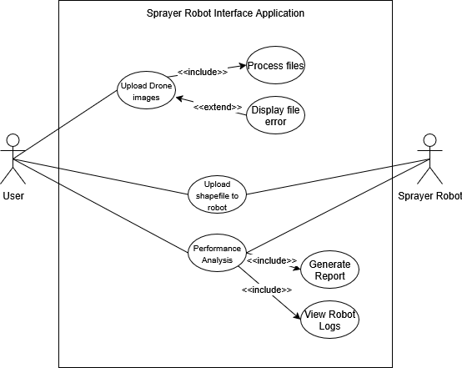
UML Diagram

Slide 9
Evaluation of existing systems
Currently, no robotic sprayer automation
Andrew already does image stitching for field map
  Uses Pix4D which automatically does field analysis
  Not free, wants us to use NodeODM instead
No existing codebase for classification algorithm
  Build up from scratch
  Two options: FIELDimageR or DINOv2 fine-tuned model
Have access to Farm-ng robot
Current limitations for Andrew:
  No path finding for automated sprayer
  No instruction generation for robot

Slide 10
Kanban Board

Slide 11
Demo

Slide 12
Logan Sutton’s Learning
Needed to learn as backend developer…
  FastAPI for backend endpoints
  NodeODM API for image stitching
    PyODM library
  Docker for NodeODM image
Learning Resources
  Utilized AI tools for simple FastAPI syntax queries
  Read NodeODM documentation on API
  Read PyODM python library documentation and code samples
Outcomes
  I learned about docker images & containers
    How to start and stop them via command line
  Utilize PyODM library to start and poll status for jobs

Slide 13
Gil Rezin’s Learning
Learn fast in unfamiliar domain
  Asked lots of questions to the stakeholders
  Obtained insight from Ag Tech students
  Independently researched existing farming systems
Learning Resources and Strategies
  Utilized ChatGPT to generate ideas, pipelines, and challenges when planning algorithm model
  Read FIELDimageR library documentation, code samples, and YouTube tutorials
Outcomes
  Learned about techniques in agriculture to utilize technology to better optimize crop output
    NDVI, NDRE metrics
    Classification models
  Prepared for next steps in algorithm design

Slide 14
Sprint Achievements and Challenges
Achievements
Tentative UI
Backend upload route
Backend status route
Can run a job with NodeODM from API
Feel like we have grasp of requirements
Challenges
Difficult to communicate with client
Unclarity of what implementation should be for path finding
Uncertainty with using John Deere ATU or self developed system
Slow getting started, multiple extensions
  Feel like we are back on track now

Slide 15
Gen AI
Cursor IDE used for
  Full frontend visuals (as requested by client)
  Backend template outline
  Some documentation, such as intermittent README.md
  Script generation, such as package.json
    Ex. npm run nodeodm:start
  Brainstorming implementation ideas / best practices
  Some test cases
ChatGPT used for
  Formatting provided ideas into formal statements
  Generating some additional functional requirements
  Providing insights into ML models and model pipelines

Slide 16
Gen AI
Checks
  Always verified code for expected output
  Reviewed AI output for clarity and correctness by reviewing requirements
Retrospective
  AI performed well for user UI creation
  Provided a solid backend API foundation to build upon
  Generated beneficial command line shortcuts for ease of use
  Created well formatted and coherent text for documentation
  Areas to improve
    Ensure prompts are specific to reduce AI errors

Slide 17
Thank you!
We’re excited to continue developing this system in Sprint 2!

